Slide 1
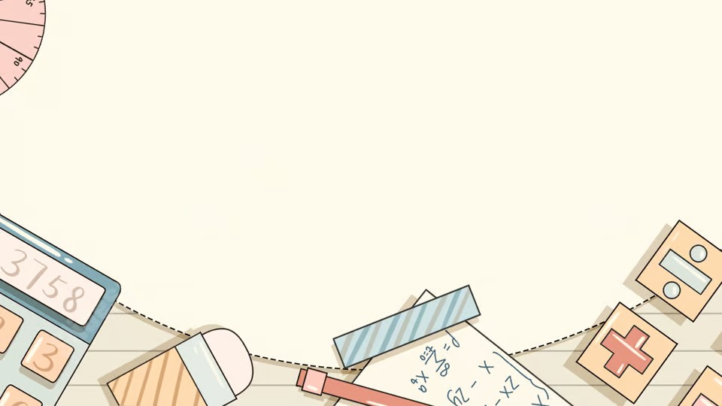
Image Processing
Using Fourier Transform

Slide 2
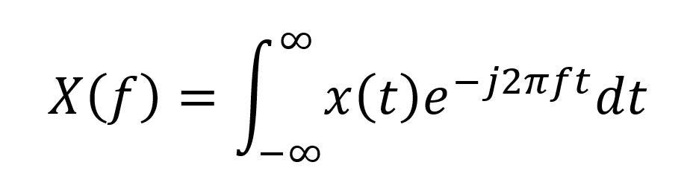
What is Fourier Transform
The Basic Idea is to Transform the signals to a bunch of frequencies using the Fourier Transform formula

Slide 3
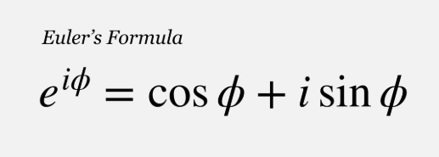
How Does it Work
- Using the Formula we make the signal into a SIN & COS functions to help us modify it
- We Use a Euler Formula to Represent the sin and cos into one simple line

Slide 4
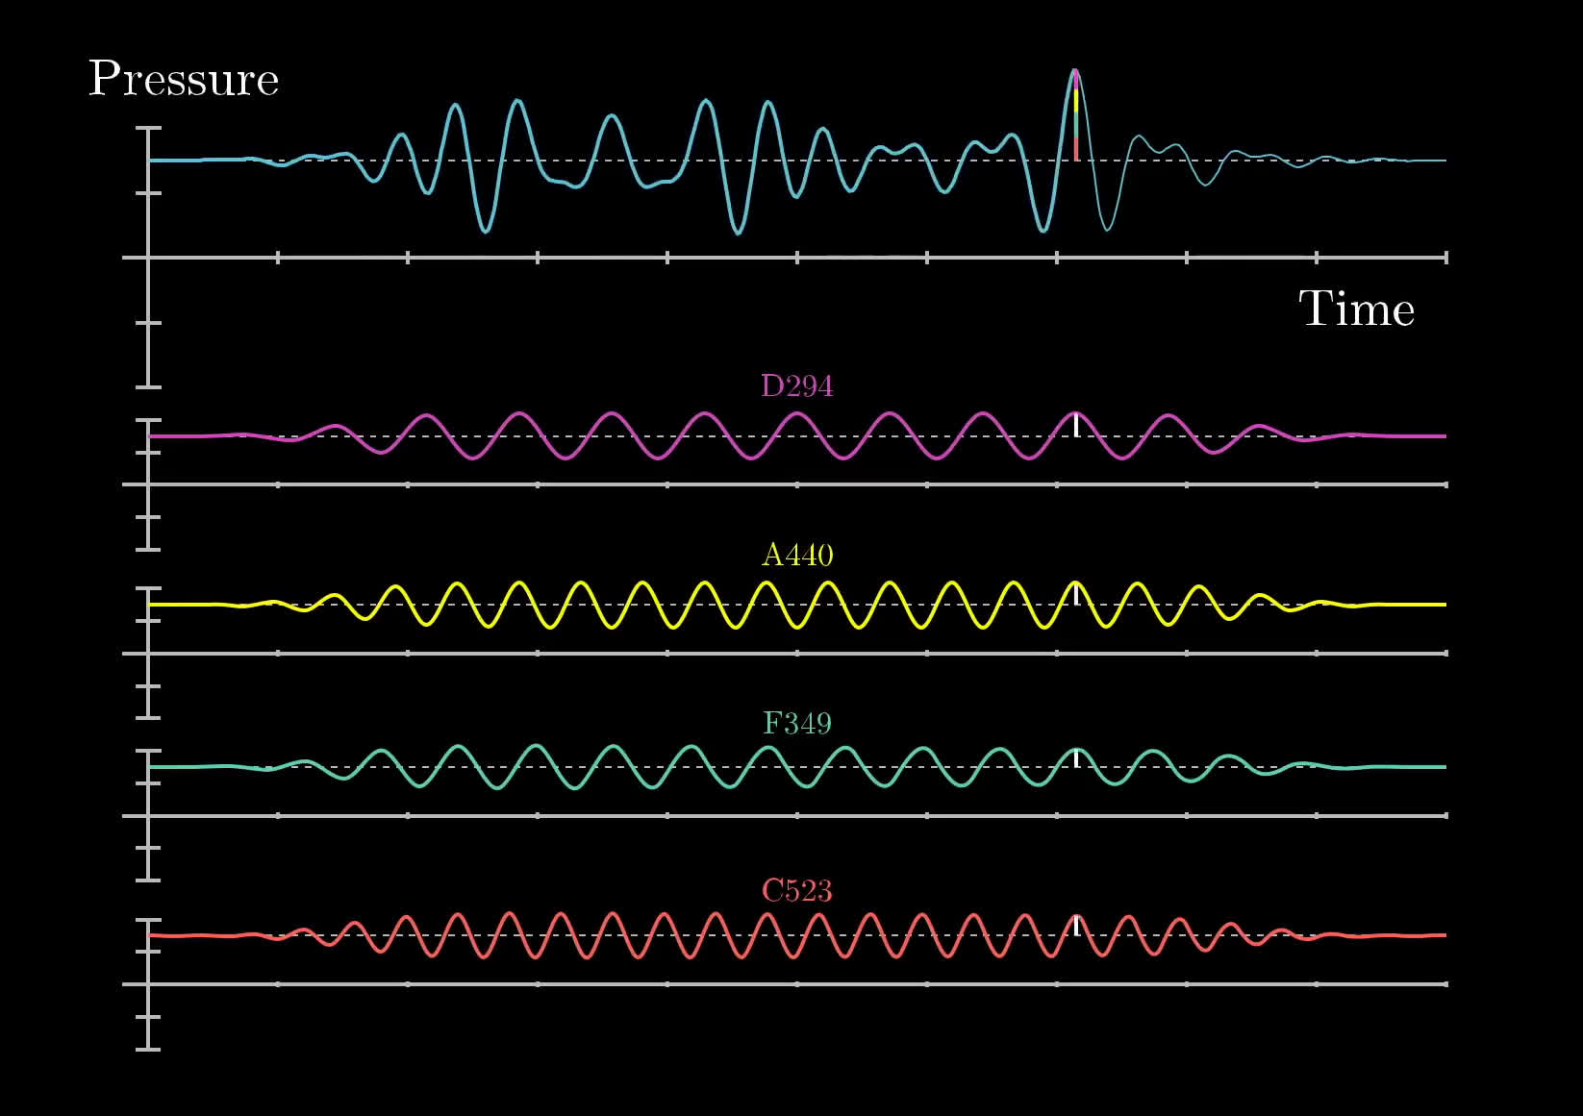
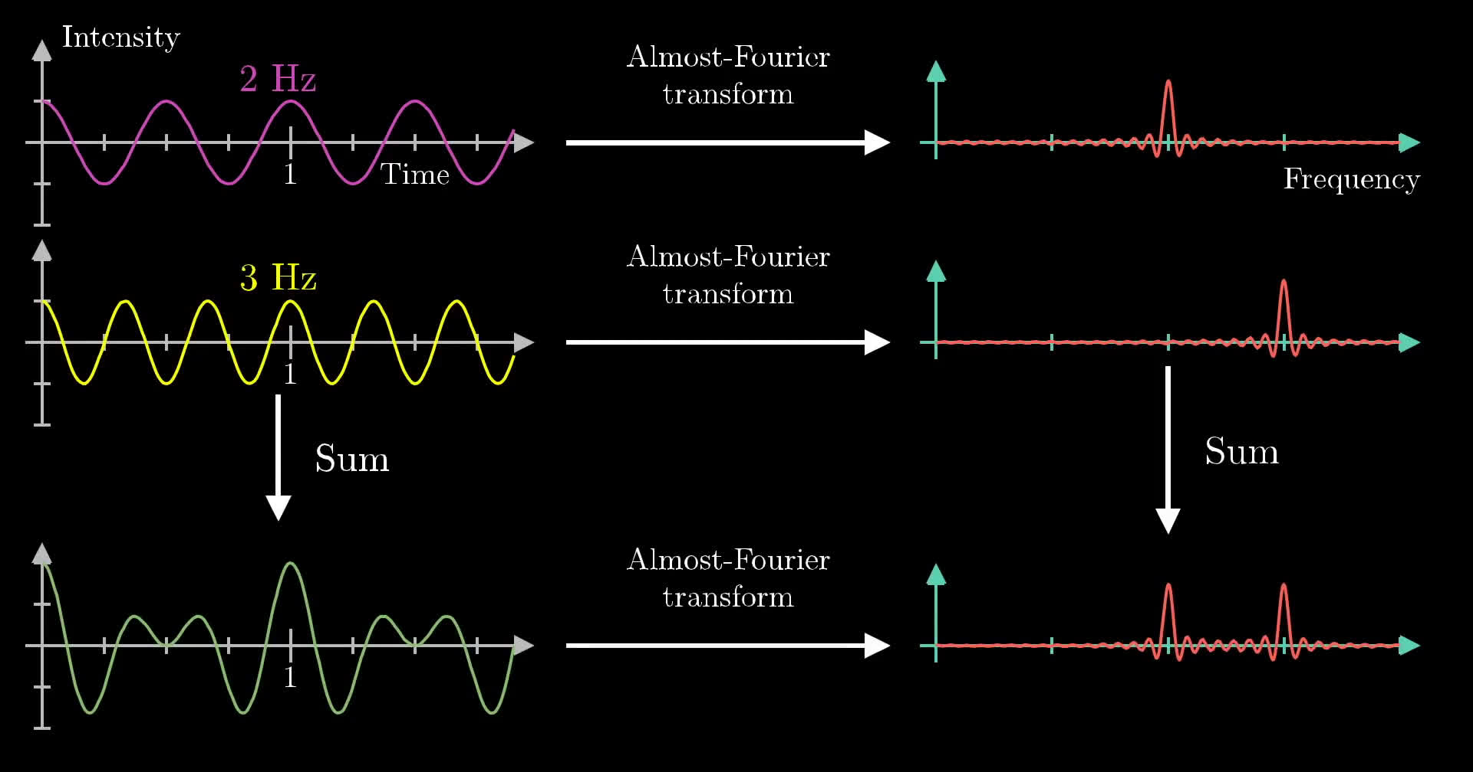
Here We Have a Signal
We represented it in the time domain and transformed it to a Frequancy Domain to Help us modify it Later

